Slide 1


Your community
A world
of connections
Atlas, the affiliated networks program
North America · Europe · International
Version 2.3 · EN

Slide 2
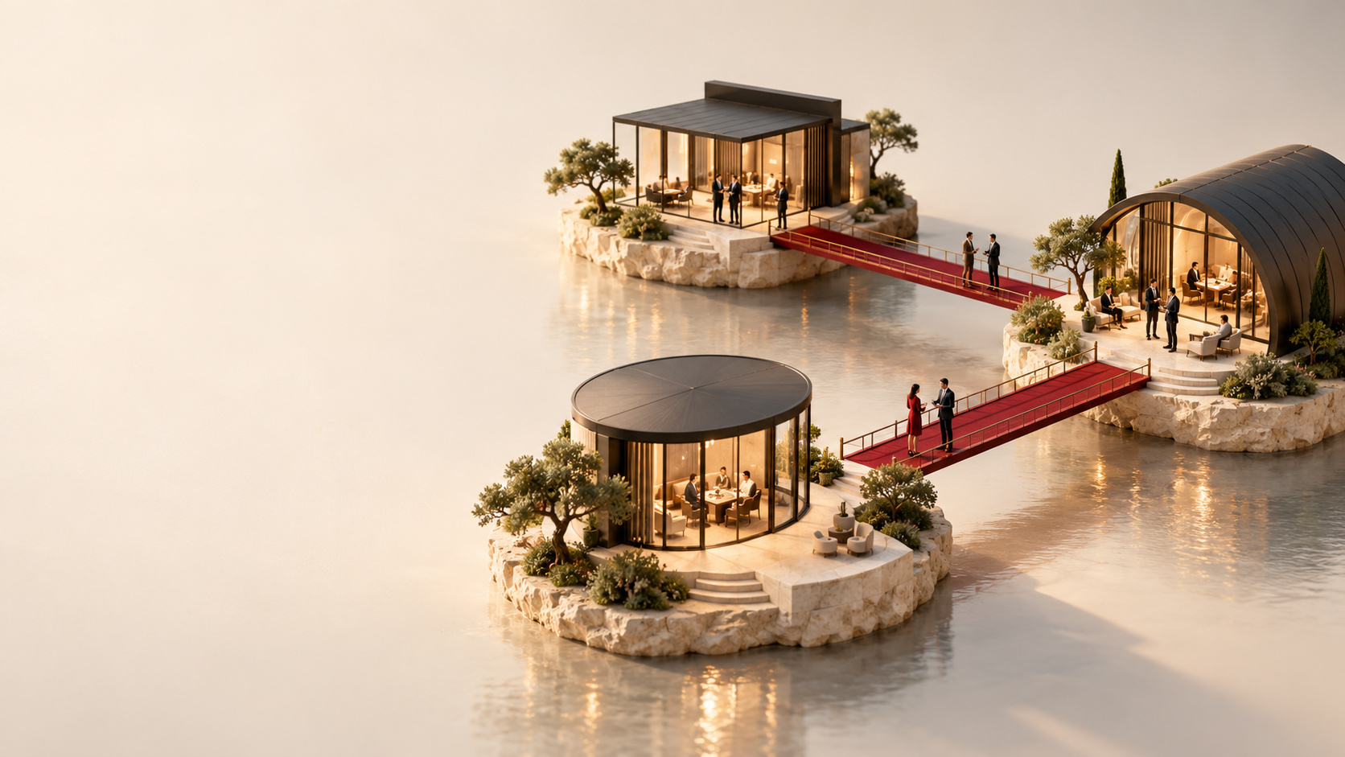
Your network
keeps its
identity
Your name. Your mission.
Your leadership.
You keep the relationship
with your members.
Atlas connects communities
around GR International.

Slide 3
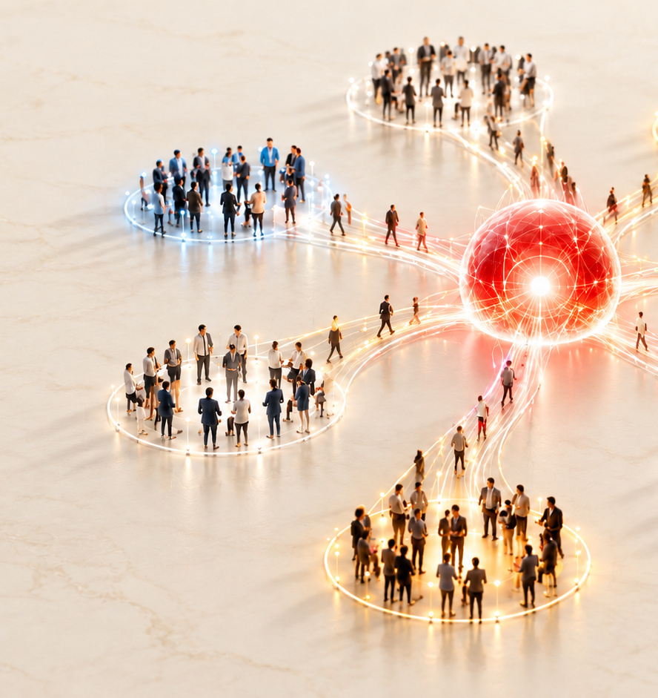
New connections
for your
members
Connections with GR communities
in North America, Europe
and internationally.
Meetings shaped by
your members’ needs.
An offering that complements
your own.

Slide 4













Your community has a place
in the GR ecosystem
BUSINESS NETWORKS
COWORKING
CHAMBERS OF COMMERCE
ENTREPRENEUR COMMUNITIES
PROFESSIONALS AND AGENCIES
NONPROFITS & SUPPORT
Examples of communities we aim to reach. Discussions are underway with some organisations.
Their presence on this slide does not confirm any affiliation with GR.
Notes:
Official logo sources:
hedhofis — https://www.hedhofis.com/ — https://www.hedhofis.com/hubfs/GROW%20-%20Hedhofis/hedhofis-logo-black.svg
frenchfounders — https://www.frenchfounders.com/home — https://www.frenchfounders.com/img/logo_ff_large.mondrian.svg
ccmm — https://www.ccmm.ca/fr/ — https://www.ccmm.ca/~/media/Images/Homepage/Logos/CCMM_logo_FR.png
miami — https://www.miamichamber.com/ — https://www.miamichamber.com/hubfs/GMCC%20Horizontal-SM-2.png
wojo — https://www.wojo.com/fr-FR — https://www.wojo.com/_next/static/media/wojo-logo-full.693f5c6a.svg
rfaq — https://www.rfaq.ca/ — https://cdn.ca.yapla.com/company/CPYuOcftTLxWNKYl2XaD7pzI0/account/logo_rfaq_rgb-1707251229-1709587209.png
business-chicks — https://www.businesschicks.com/ — https://images.squarespace-cdn.com/content/v1/64fad11dfd75140c94b9e3e9/5cb18e1c-fecf-47fa-9f98-bc94774f2b7c/Business-Chicks-Logo_RGB-1536x1093.png
toronto — https://www.bot.com/membership — inline SVG in official header
bni — https://www.bni.com/country/canada/ — https://www.bni.com/wp-content/uploads/2024/09/BNI_logo.png
tony-elumelu-foundation — https://www.tonyelumelufoundation.org/ — https://www.tonyelumelufoundation.org/wp-content/uploads/2021/10/TEF_Logo_White_Bg.png
remax — https://pourquoiremax.com/contact/ — https://pourquoiremax.com/wp-content/uploads/2022/12/Logo-Remax.svg
exp — https://www.groupehorizon.com/ — https://static.wixstatic.com/media/022e06_5fe6e51286224ca69fe2f3b0e06c8197~mv2.png

Slide 5

Network affiliation,
individual choice
Your organisation
Silver Partner status or higher.
It joins the Atlas program.
Each interested member
GR Passport or Signature.
Their choice, with no obligation.
Passports are separate from the network’s affiliation.

Slide 6

Silver Partner
NORTH AMERICA
CAD 2,499
per year
EUROPE
€1,499
per year
INTERNATIONAL
From USD 249 / year
Partner status for your organisation
Visibility in agreed materials
Access based on the local offering
12 months, excluding taxes. Passports cost extra.

Slide 7
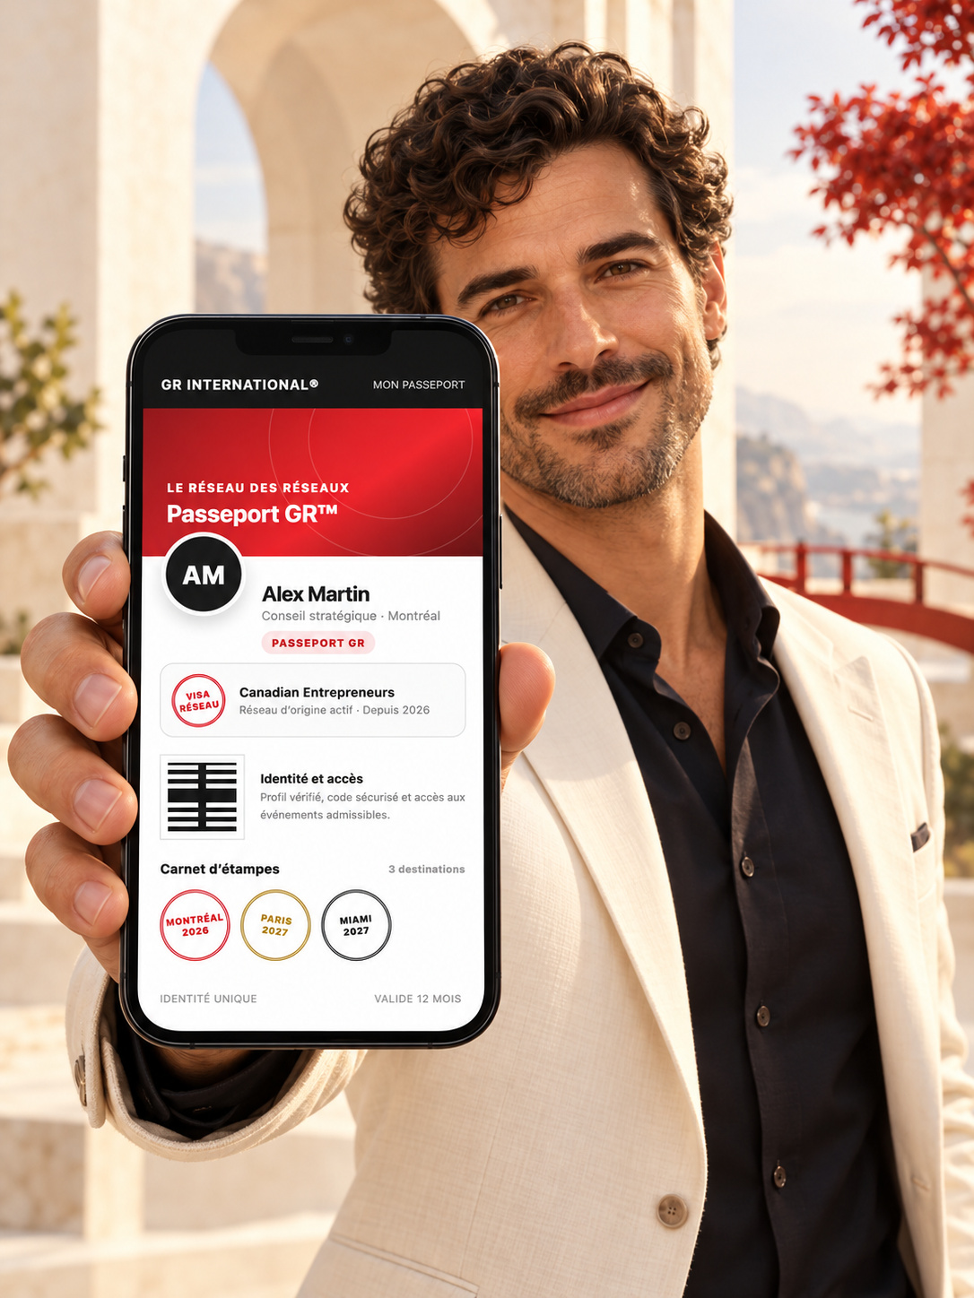
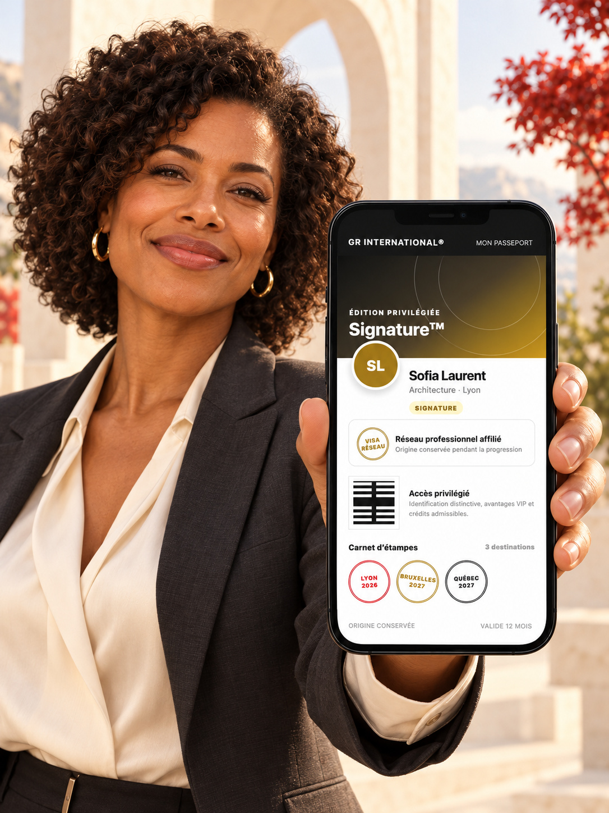
Two Passports, a personal choice
GR PASSPORT
GR PASSPORT
SIGNATURE
North America
North America
CAD 150
CAD 300
Europe
Europe
€150
€300
International
International
Local pricing on request
Local pricing on request
12-month profile visibility and participating events
Six eligible visits to Formule GR™
Everything in the GR Passport, plus…
10% discount on eligible purchases
and double referral credits
12 months, excluding taxes. Activities subject to conditions. Credits are not redeemable for cash. Illustrative visuals.

Slide 8

A financial contribution
to your network
1/3
One third of the price actually paid
after discounts
GR Passport: 150 generates 50
Signature: 300 generates 100
Examples in CAD or EUR, without discounts.
Calculation and payment follow the affiliation agreement.

Slide 9

An example,
not a forecast
20 GR Passports
15 Signature Passports
NORTH AMERICA
EUROPE
CAD 2,500
€2,500
in contributions to the network
20 × 50 + 15 × 100
INTERNATIONAL · Contribution based on local pricing
Example without discounts, before affiliation costs and adjustments.
No guaranteed volume or income.

Slide 10
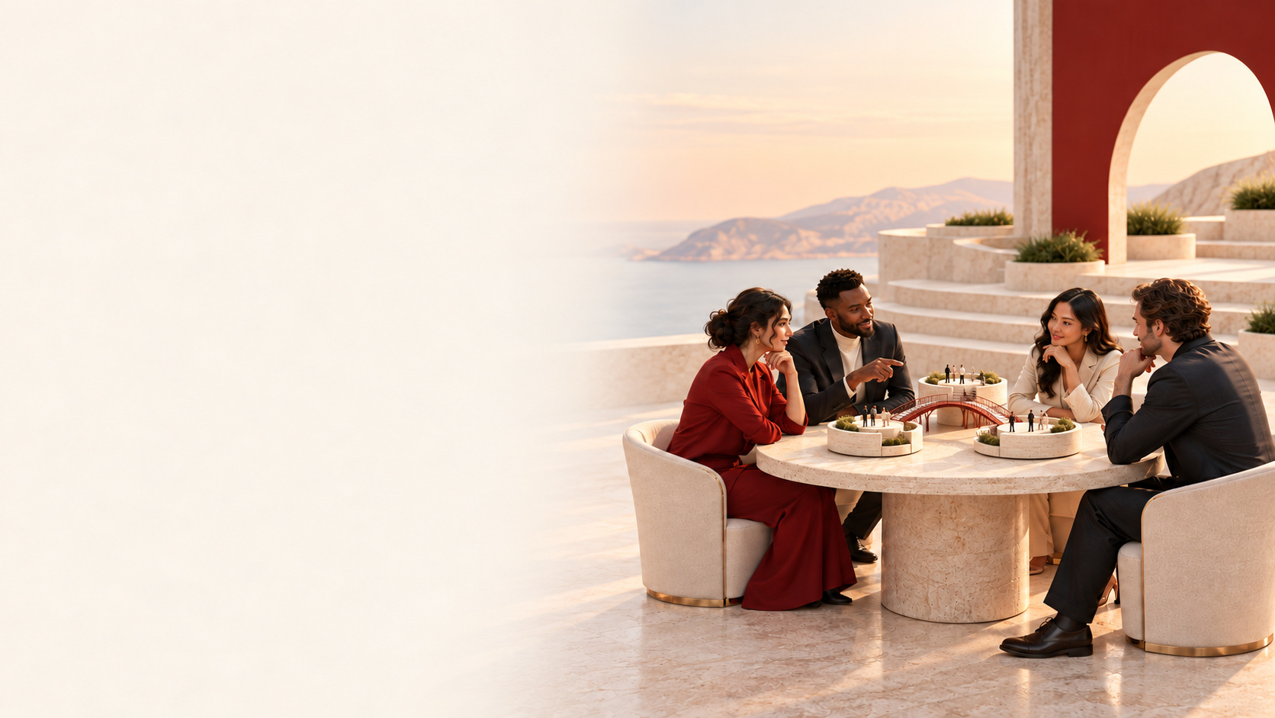
A shared launch
Together
We identify the needs
and useful access options.
Your network
You approve the message
and share it.
GR
GR speaks with interested members
and helps them choose.

Slide 11
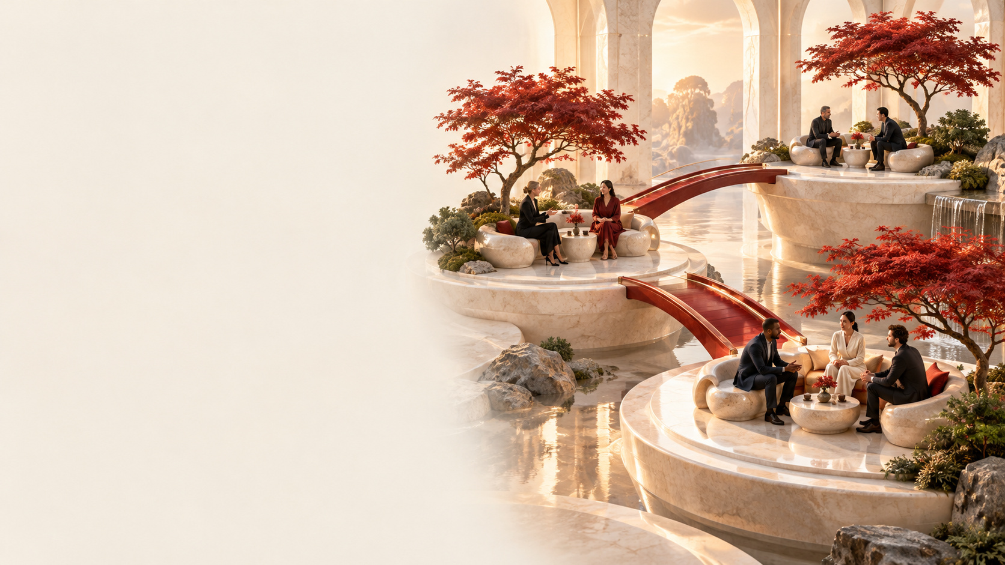
Your members’
trust
The Passport remains optional.
Your membership database
stays with you.
GR speaks with people who express
interest or give their consent.
No mass solicitation.

Slide 12

A two-way
partnership
Agreed visibility
activities
A designated GR contact
A review of activities,
usage and revenue shares
Written commitments
before launch.

Slide 13

Your community
in the Network
of Networks™
Which connections would be
most useful to your members?
The next step:
Meet our business
development team.
Idea and concept: Éric Pichette and Olena Pichette

